Slide 1
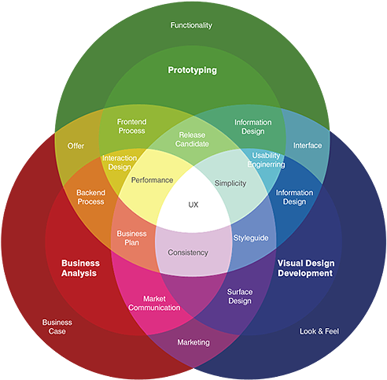
UX Design

Slide 2
Content week 2
Taste a bit of everything of a UX designer
Introduction to User experience

Slide 3
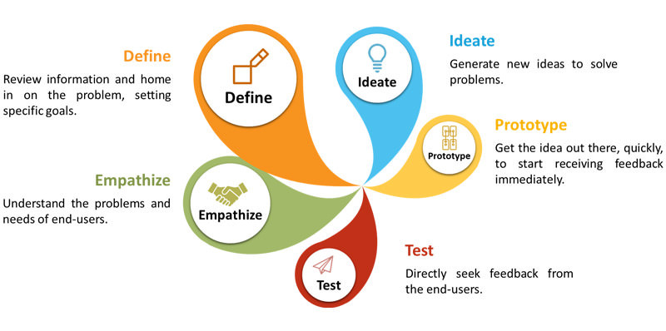
UX design cycle
Weeks 7 & 8
Weeks 3, 4 & 5
Week 13

Slide 4

What do you think of a UX designer
What do they do ?
Notes:
Ask students about how they would think of a ux designer’s job?

Slide 5

What’s a UX designer like?
https://youtu.be/ORZlHuD22UQ
https://careerfoundry.com/en/blog/ux-design/a-day-in-the-life-of-a-ux-designer/

Slide 6
a day of a UX designer (in ASML)
Scrum meetings with the whole team
Discuss with stakeholders to collect the requirements for the new functions
Evaluate the clickable prototypes with users
Make prototypes in Axure
Brainstorm on the new software strategy ( workshop)
Discuss with a Graphic designer to work on the design guidelines together
Adapt mockup with Illustrator
Work on the CSS code for a Java application
Check with the development team if the implementation is consistent with the design
Notes:
Based on my personal work experience in ASML

Slide 7
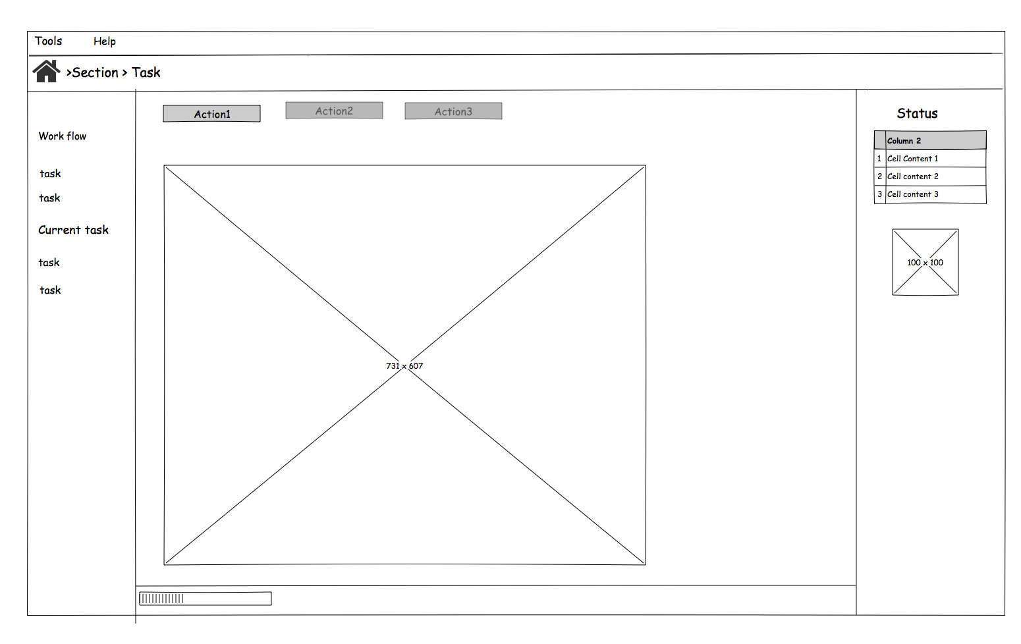
Deliverables: simple Sketch
Notes:
Simple Sketch made by Pencil (1st stage)

Slide 8
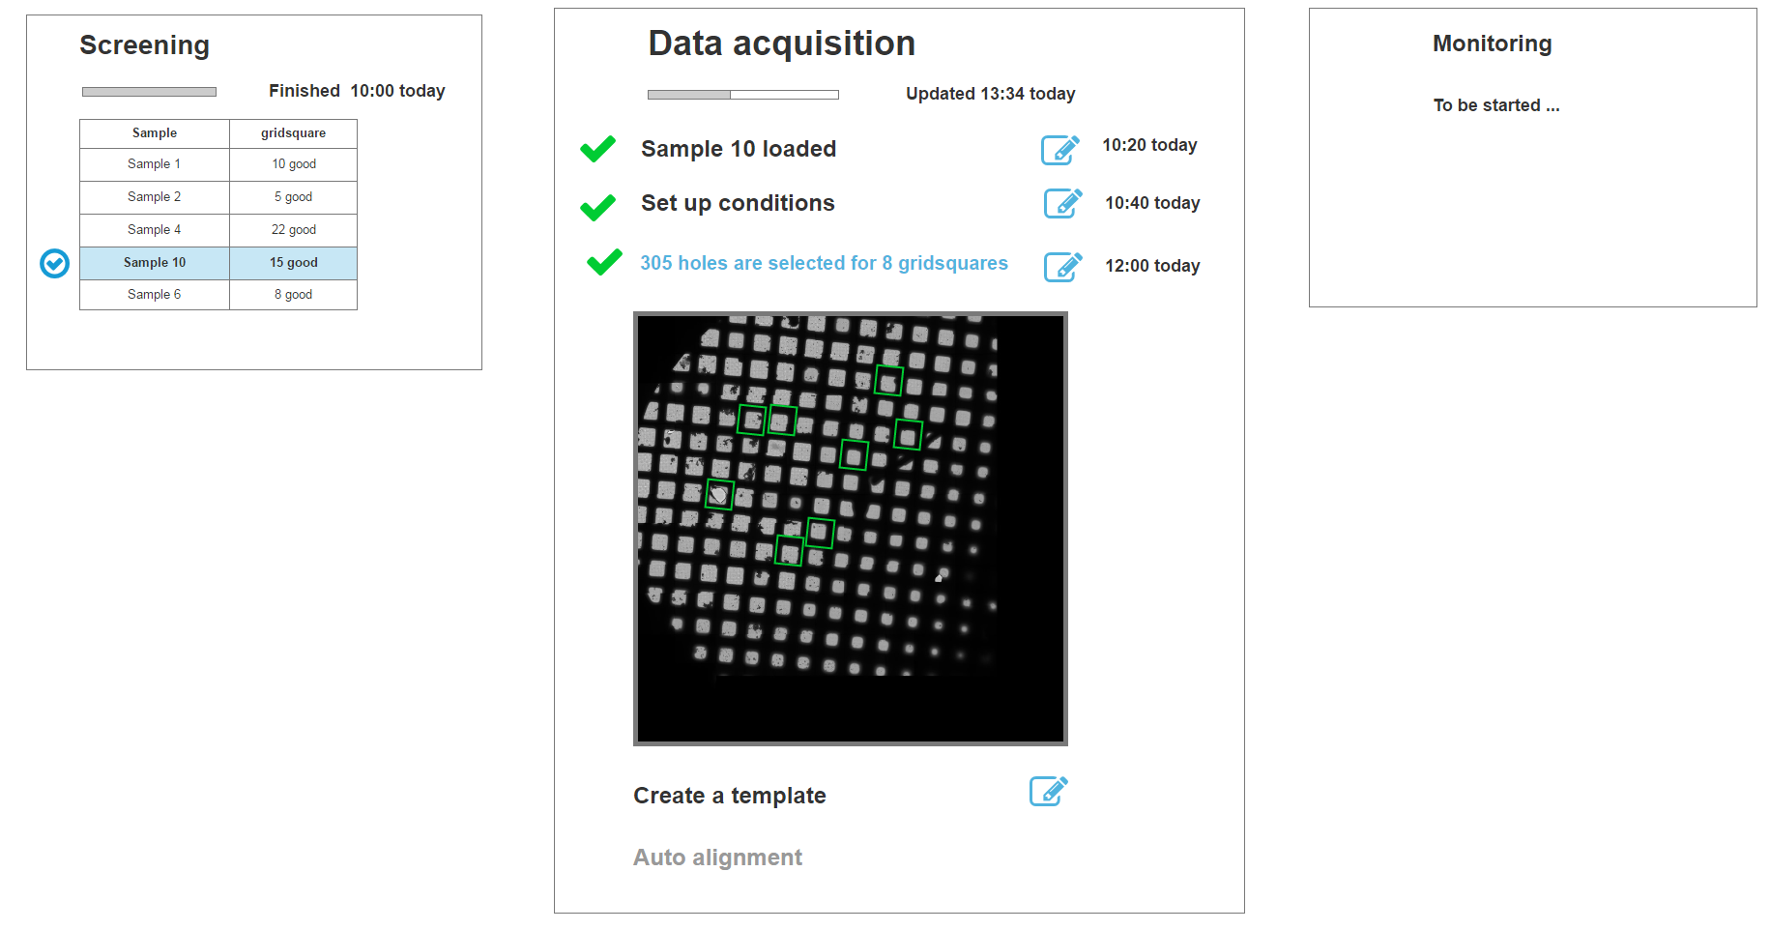
Deliverables: Interactive prototype
Notes:
Interactive prototype made by Axure Pro

Slide 9
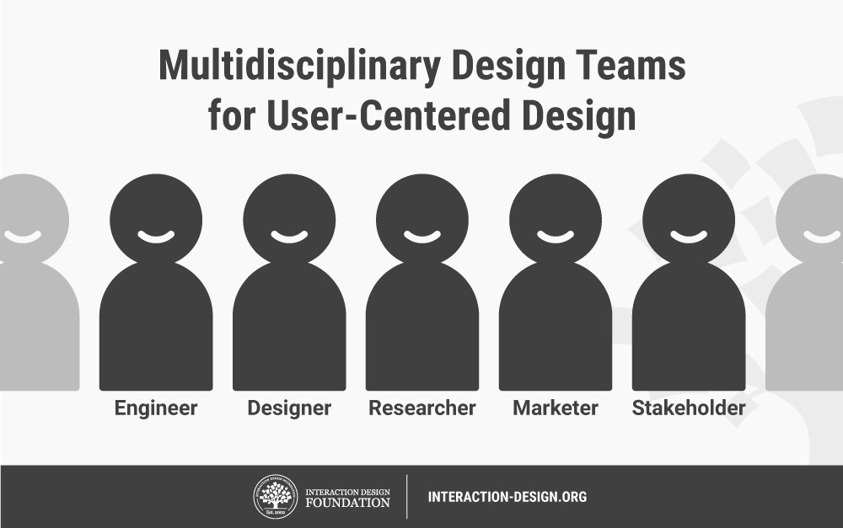
UX designer in an organization
https://public-media.interaction-design.org/images/uploads/4330318ee335442f9067c080862a91fe.jpeg

Slide 10
What kind of jobs of a UX designer ?
Go to :
https://www.indeed.nl
or
https://nl.linkedin.com/jobs/
Search for : UX designer

Slide 11
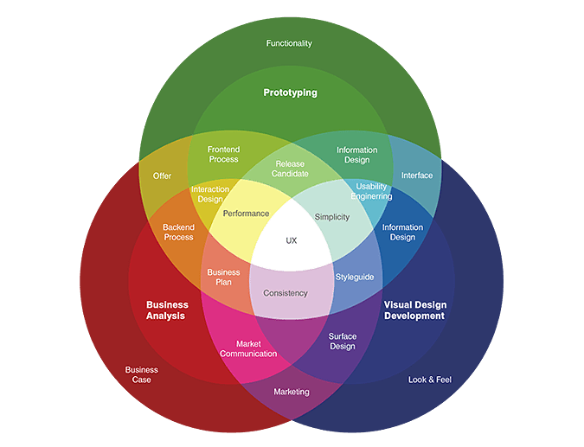
Types of UX designers
Information architect
Interaction designer
UI developer
Graphic designer
Usability engineer
User testing
UX strategy
https://www.uxbeginner.com/how-to-navigate-the-ocean-of-ux-job-titles/

Slide 12
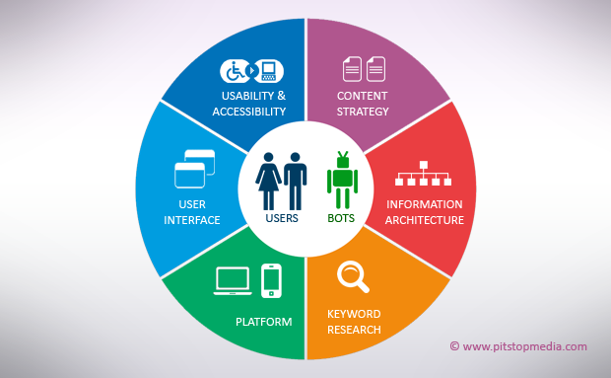
UX focus

Slide 13
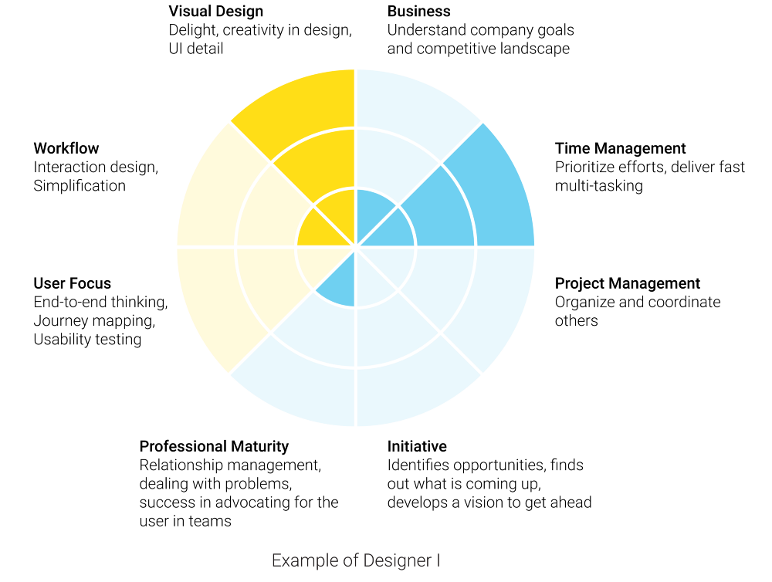
Skill sets designer 1
https://medium.com/@rtwest/demystifying-promotion-in-ux-5fb902ffddeb

Slide 14
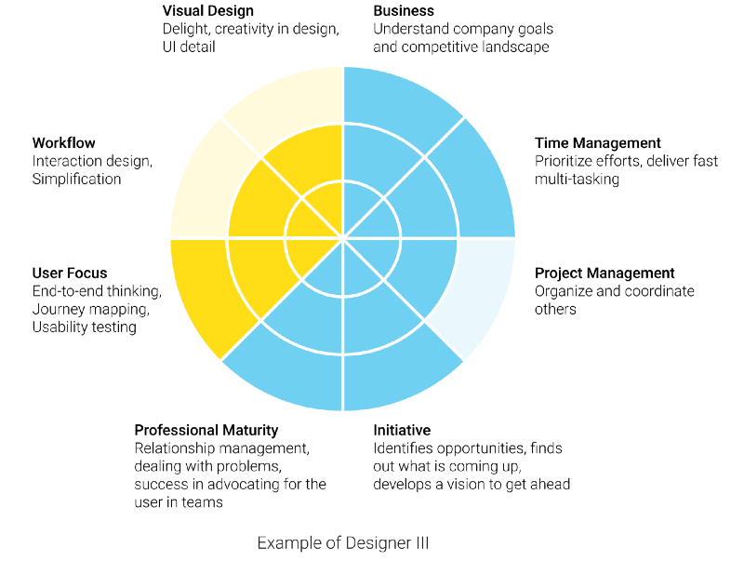
Skill sets designer 2
https://medium.com/@rtwest/demystifying-promotion-in-ux-5fb902ffddeb

Slide 15
Different skill sets
UX design related jobs | Skill sets (tools)
Information architect | Sitemaps, Wireframes, User Flow Diagrams, Customer Journeys, navigation
Interaction designer | diagrams, navigation flow charts, prototypes or Flash content.
UI developer | HTML, CSS, and Javascript
Usability engineer/researcher | Human factor, ergonomic, cognitive psychology, experiment design, user testing ; HCI, Statistics
Product designer/UX strategy | interplay between brand, technology, strategy, content, psychology, etc. to craft a solution that will meet the needs of the customer/end
UI(Graphic) designer | Photoshop, Fireworks, Illustrator
https://www.justinmind.com/blog/10-must-have-skills-for-ux-designers/
https://creative.artisantalent.com/types-of-ux-jobs/

Slide 16
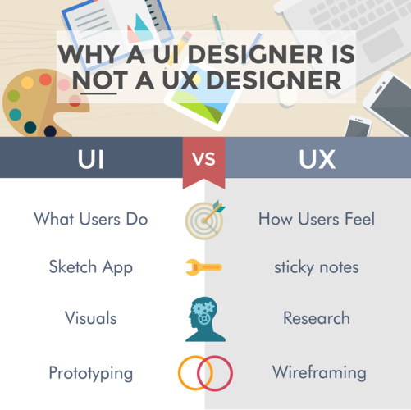
UX designer vs UI designer
https://www.coursereport.com/blog/why-a-ui-designer-is-not-a-ux-designer

Slide 17
Discussion
What’s the difference between
UX designer
Software engineer
Web front-end/back-end developer
BI expert (front-end/back-end)
Notes:
Discuss between students on the different jobs
BI front-end (infographics)

Slide 18
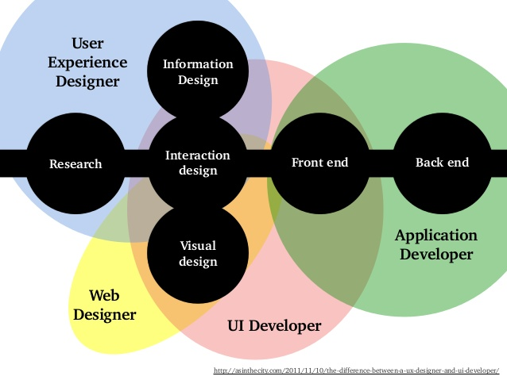
UX designer vs Web/application developer
Back-end design is UX design !

Slide 19
What is UX
How do you feel about your chair?
How do you feel about the lighting of the classroom?
How do you feel the plug ?
Notes:
Discussion about how the students feel about the classroom : experience of all those

Slide 20
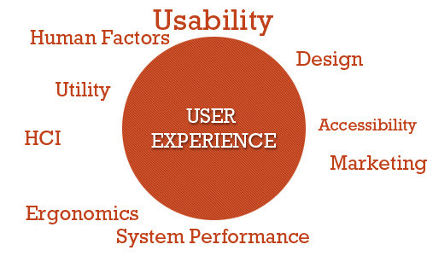
What is UX
"User experience" encompasses all aspects of the end-user's interaction with the company, its services, and its products” .
https://www.nngroup.com/articles/definition-user-experience/

Slide 21

What is UX
“person’s perceptions and responses resulting from the use and/or anticipated use of a product, system or service”
--ISO 9241–210:2010(en) Ergonomics of human-system interaction
https://youtu.be/9BdtGjoIN4E

Slide 22
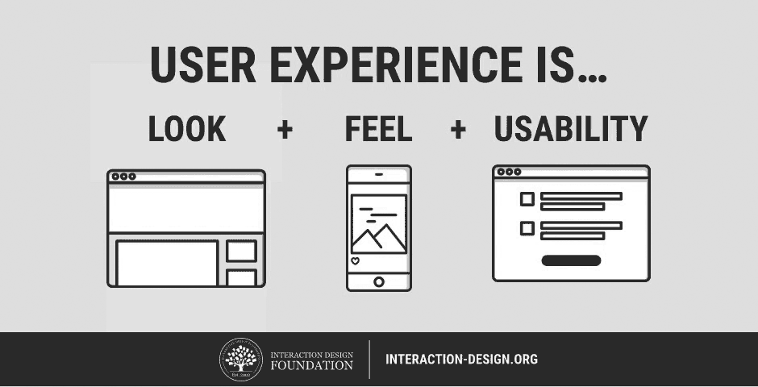
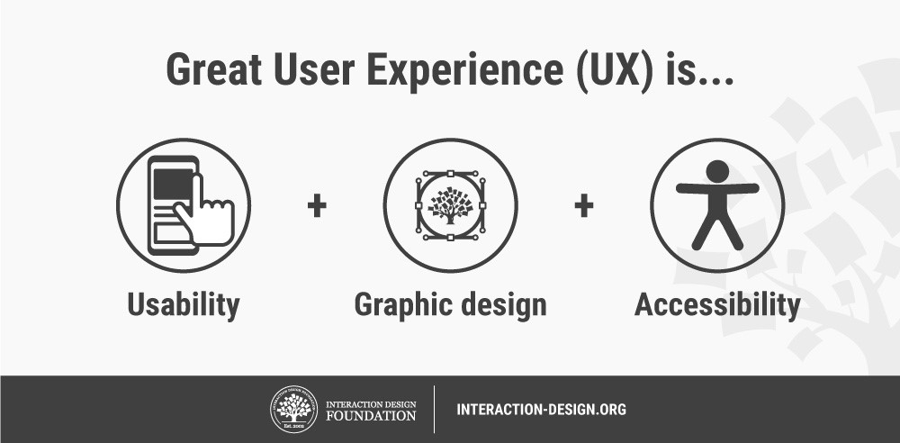
Usability vs UX

Slide 23
Usability
“the extent to which a product can be used by specified users to achieve specified goals with effectiveness, efficiency and satisfaction in a specified context of use”
Learnability
Efficiency
Memorability
Errors
Satisfaction

Slide 24
Let’s find out together
Work in groups, check an APP or website you have just used ( frequently used)
Find what you like / dislike
Notes:
Click around the website and discover the usability issues

Slide 25
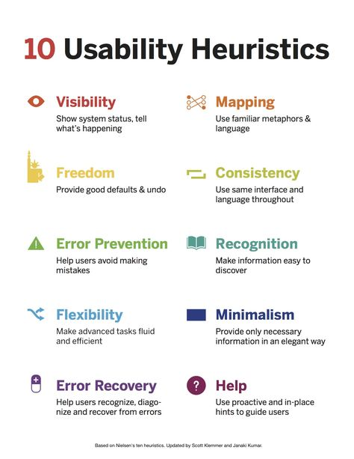

Slide 26
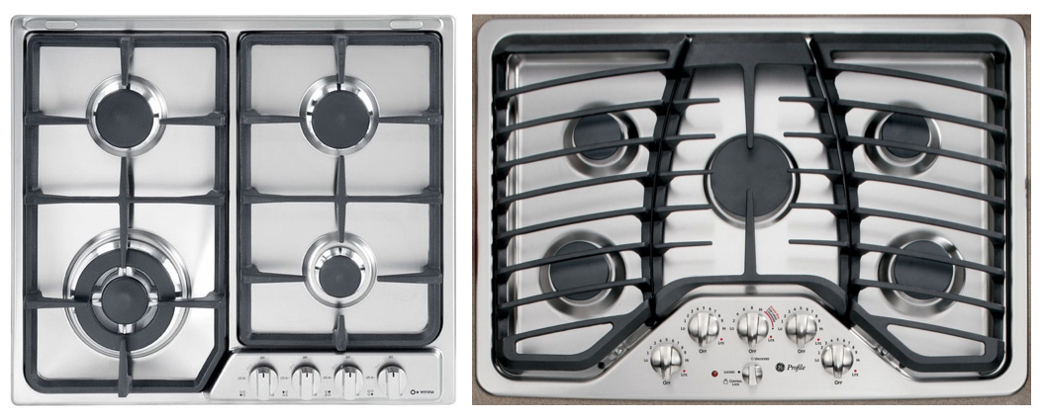
Mapping with real world
Which design is better ?
https://www.nngroup.com/articles/natural-mappings/

Slide 27
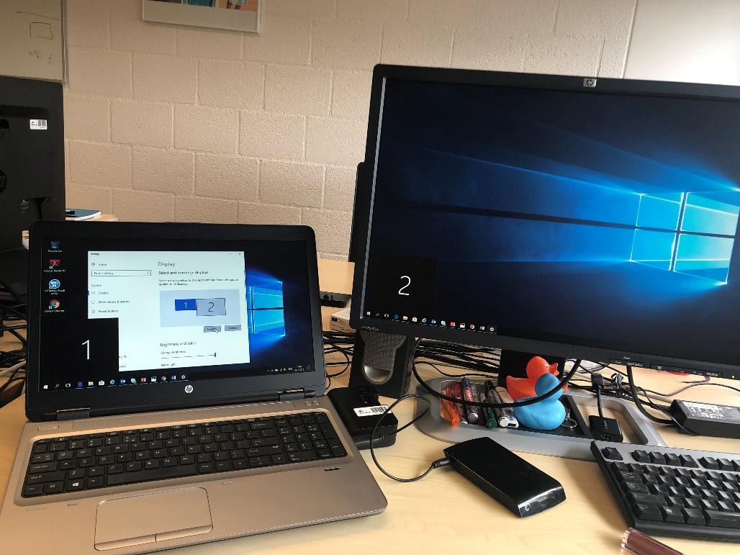
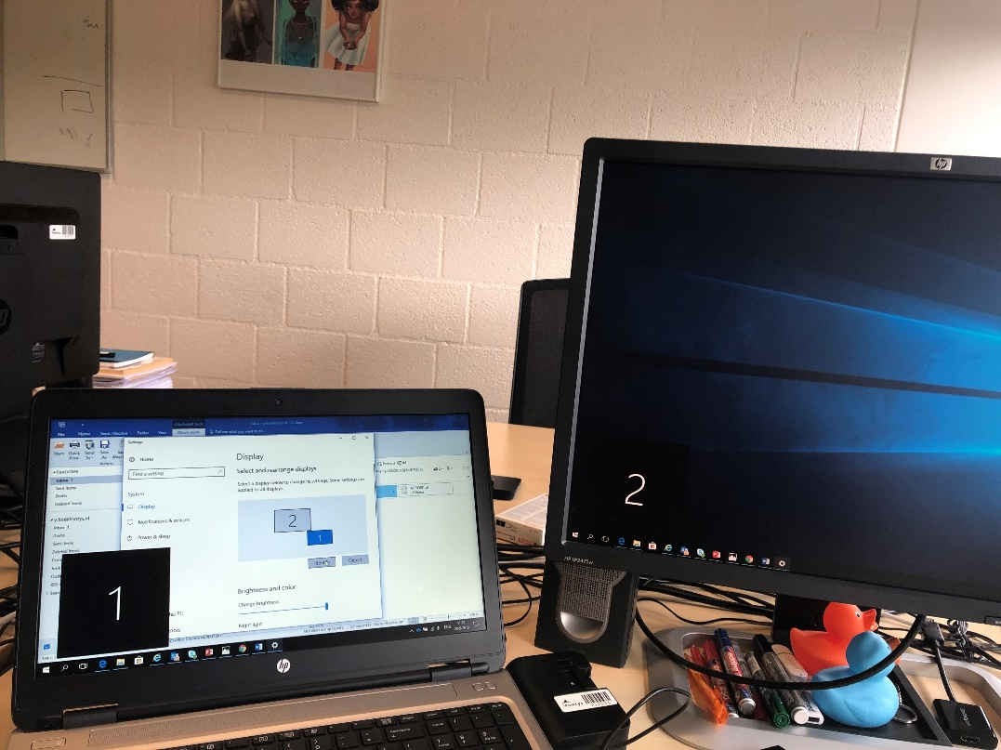
Mapping with real world
Which setting is better ?
(Spatial similarity )

Slide 28
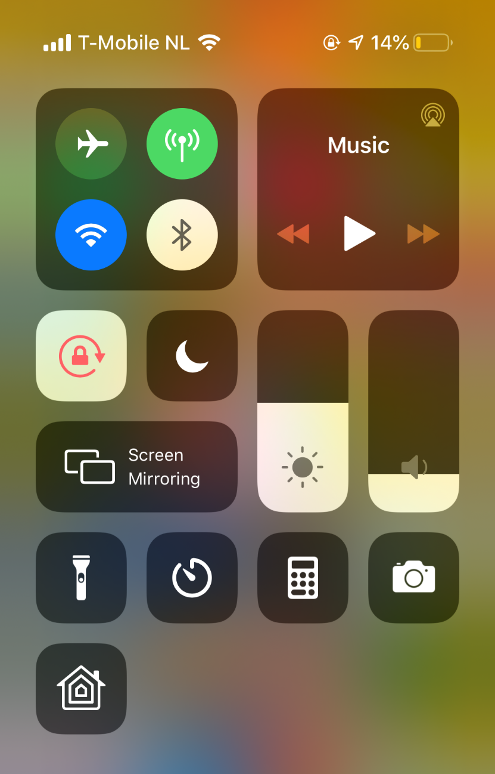
Mapping with real world
Color choice
Up & down

Slide 29
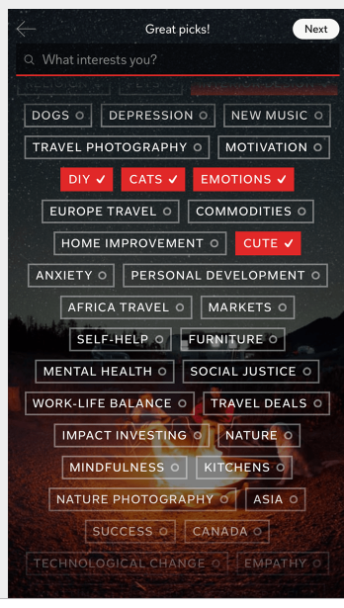
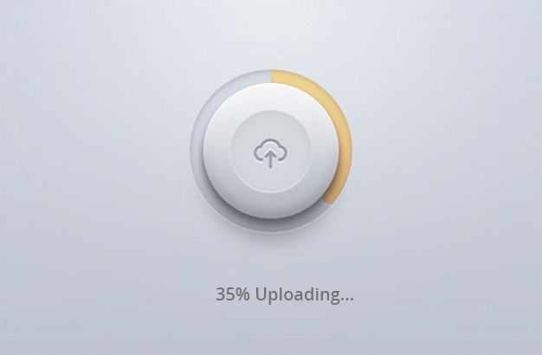
Visibility
Notes:
Giving users indication and feedback

Slide 30
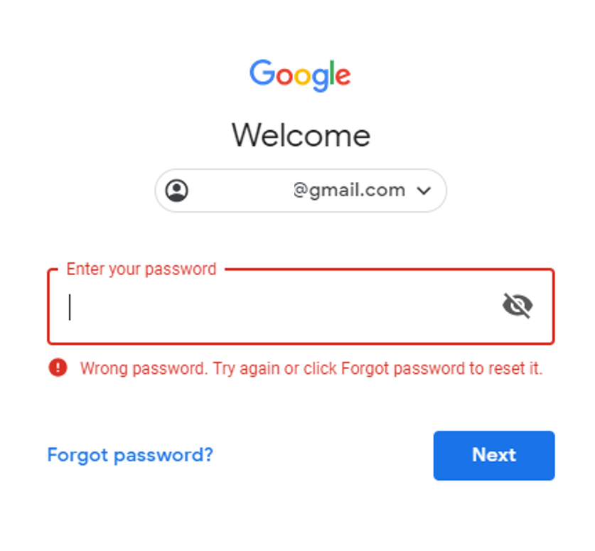
Error recovery /Help

Slide 31
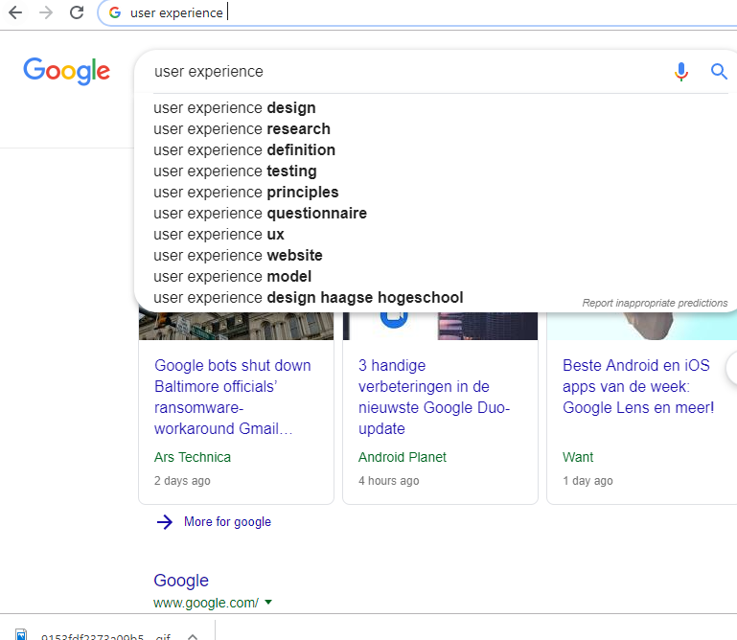
Recognition rather than recall
Error prevention

Slide 32
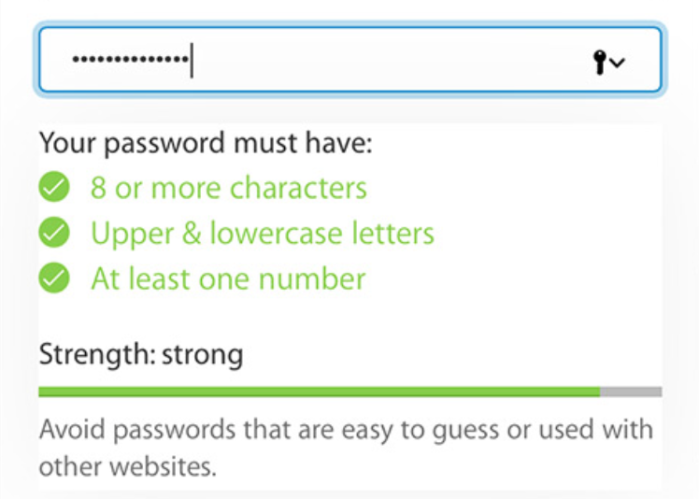
Error prevention

Slide 33
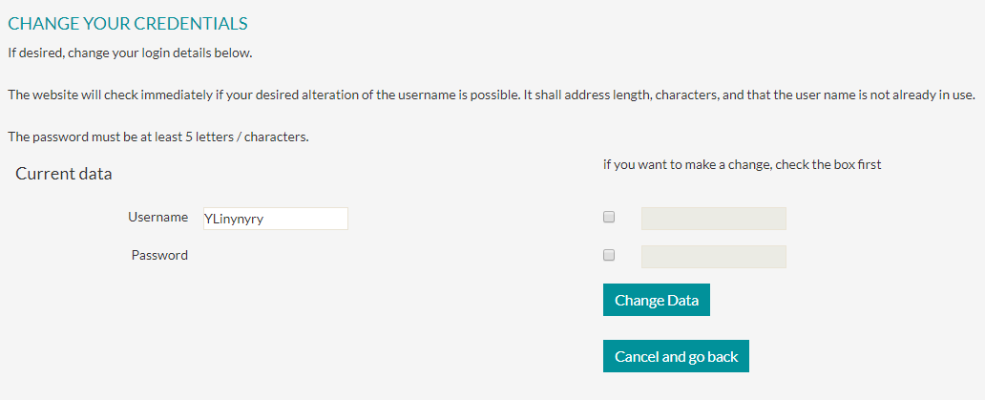
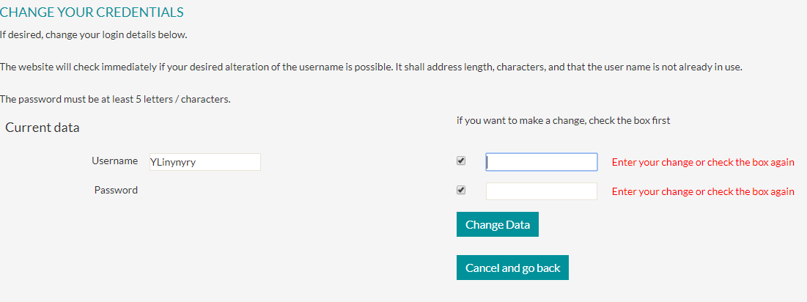
No recognition

Slide 34
How to do UX design ?

Slide 35
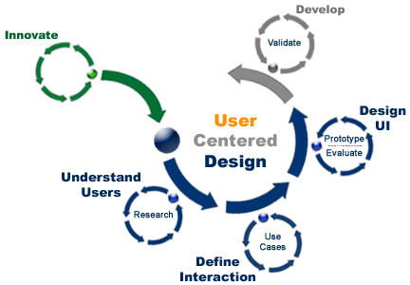
Introduction to UCD
User-centred design (UCD) is a collection of processes which focus on putting users at the center of product design and development.
https://creately.com/blog/marketing/user-centered-design-marketing/

Slide 36
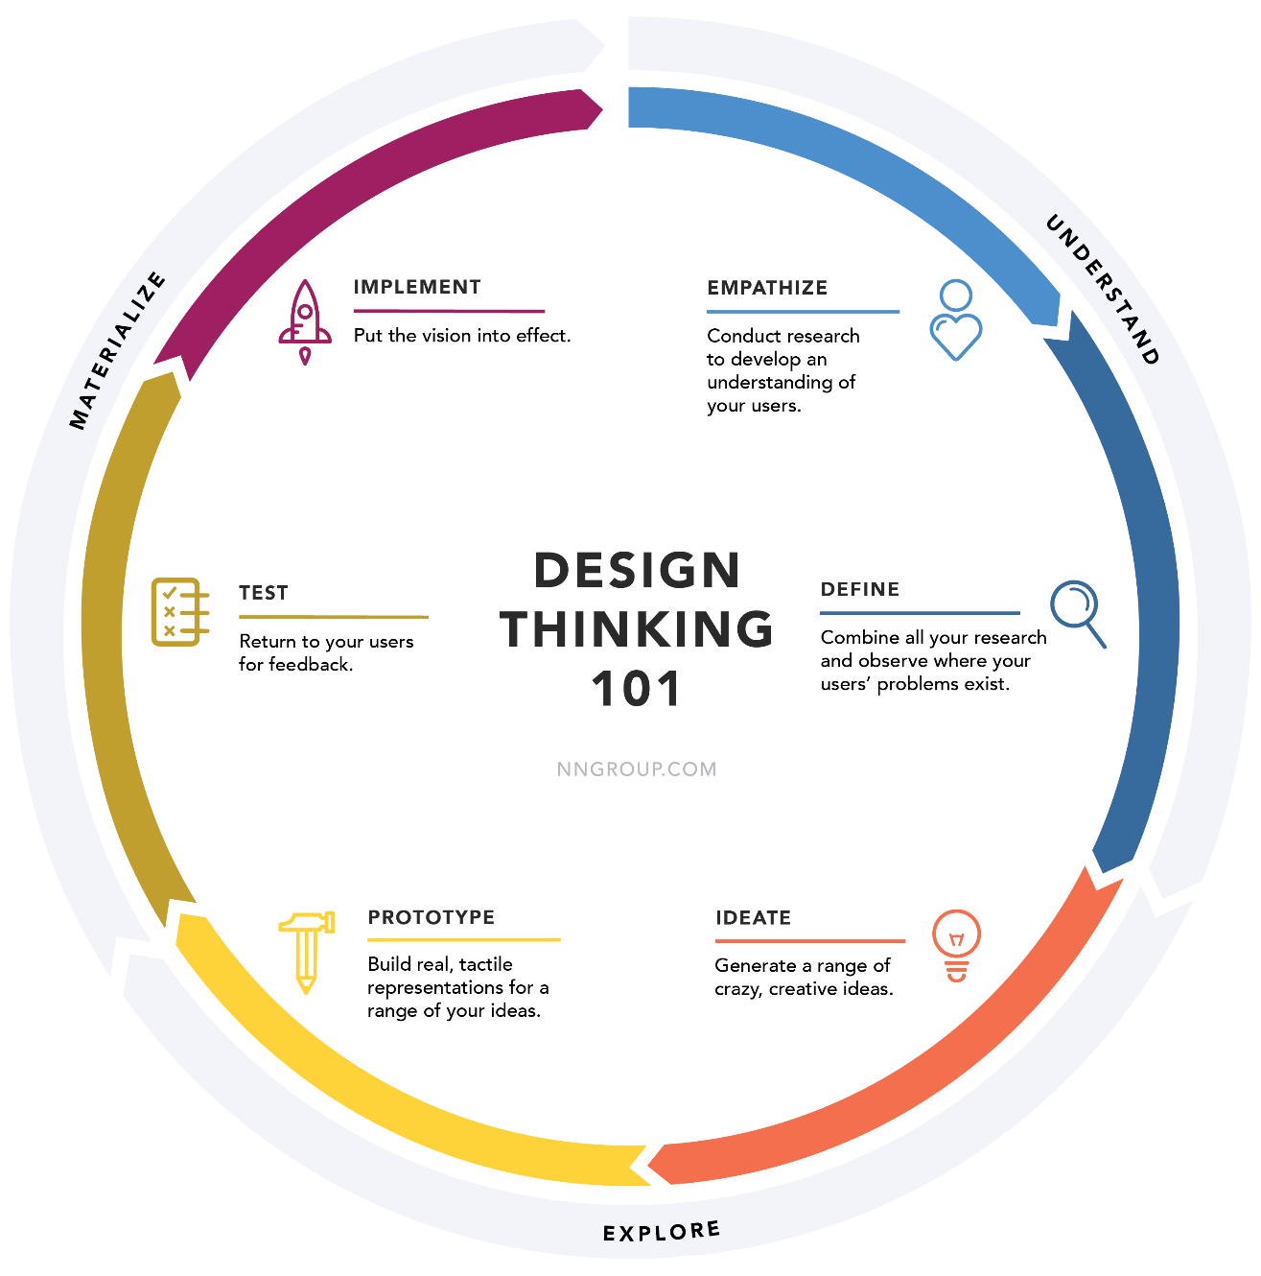
Design thinking
https://www.nngroup.com/articles/design-thinking/

Slide 37
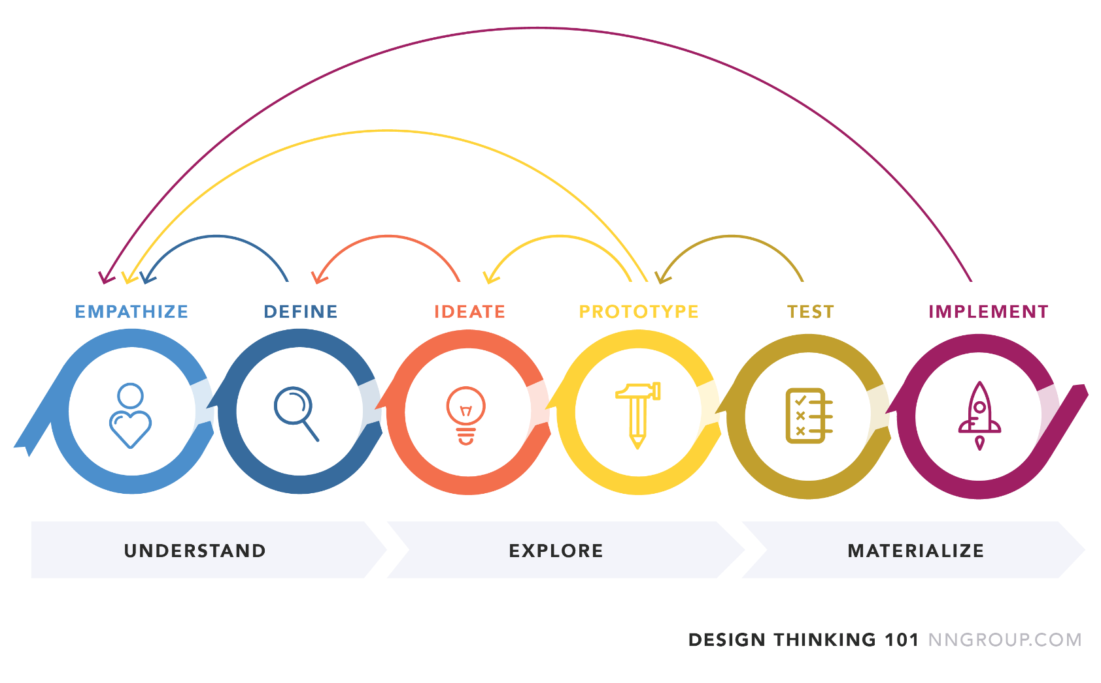
Design thinking
https://www.nngroup.com/articles/design-thinking/

Slide 38
UCD principles
A clear understanding of user
Incorporating user feedback
Early and active involvement of the user to evaluate the design
Integrating user-centred design with other development activities.
Iterative design process

Slide 39
Interesting Links
Nielsen Norman Group: https://www.nngroup.com/
Usability : https://www.usability.gov/

Slide 40
Concepting
Example : Process of coming up with the concept design of my PhD project
1 Scope and technology
2 Investigation into the problems
3 Look for concept models
4 concept design ( Wizard of Oz)

Slide 41

Assignment (see canvas)

